Slide 1
EECE 229 Introduction to Digital Systems

Slide 2
Chapter 5
Synchronous Sequential Circuit
Notes:
A synchronous circuit is a digital circuit in which the changes in the state of memory elements are synchronized by a clock signal. Asyn. Instead it often uses signals that indicate completion of instructions and operations, specified by simple data transfer protocols.

Slide 3
Overview
Sequential circuits
Latches
Flip-flops
Sequential circuits analysis
Sequential circuits synthesis

Slide 4
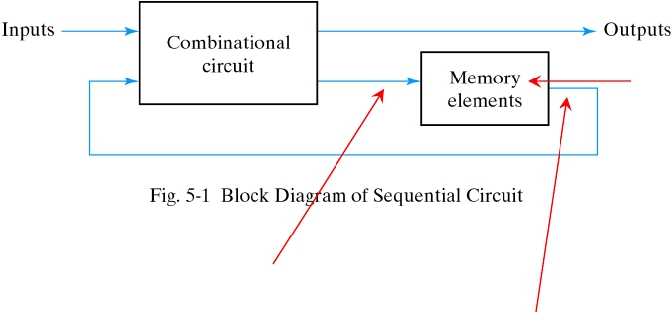
The idea of a sequential circuit
“Flip-Flops”
“Next State”
“Present State”
Notes:
The storage elements are devices capable of storing binary information. The binary information stored in the memory elements are the state of the sequential circuits at that time.
The sequential circuits receives binary information from external inputs. The inputs, together with the “present state”, determine the outputs.

Slide 5
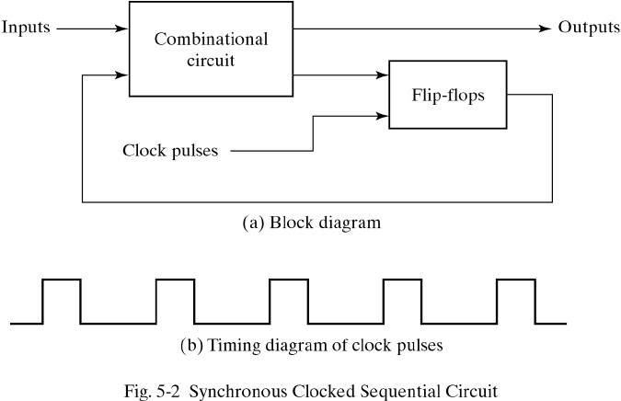
Synchronous sequential circuits
Synchronous sequential circuits: behavior can be defined from knowledge of the its signals at discrete instants of time.
Flip-flops receives input from the combinational circuits and a clock signal with pulse that occurs at fixed intervals of time.
The state of Flip-flops can change only during a clock pulse transition.
A flip-flop store one bit of information. A sequential circuit may use as many flip-flops to store as many bits as necessary.
Notes:
Asynchronous sequential circuits: depends on the input signals at any instant of time.

Slide 6
Latches

Slide 7
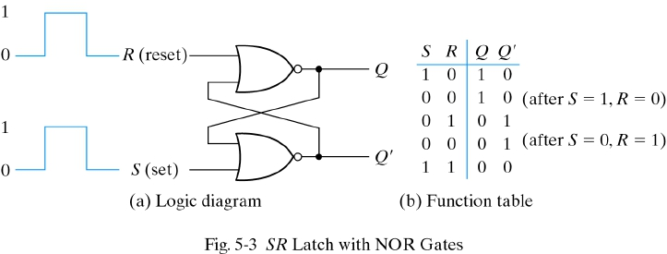
SR Latches
The most basic types of flip-flops operate with signal levels and are referred to as latches.
The latches are basic circuits from which all flip-flops are constructed.
When output Q=1 and Q’=0, it is in the set state.
When output Q=0 and Q’=1, it is in the reset state.
If S=1, R=1, both Q=0, Q’=0, it is undefined state, results in unpredictable next state. Avoid in normal operation!

Slide 8
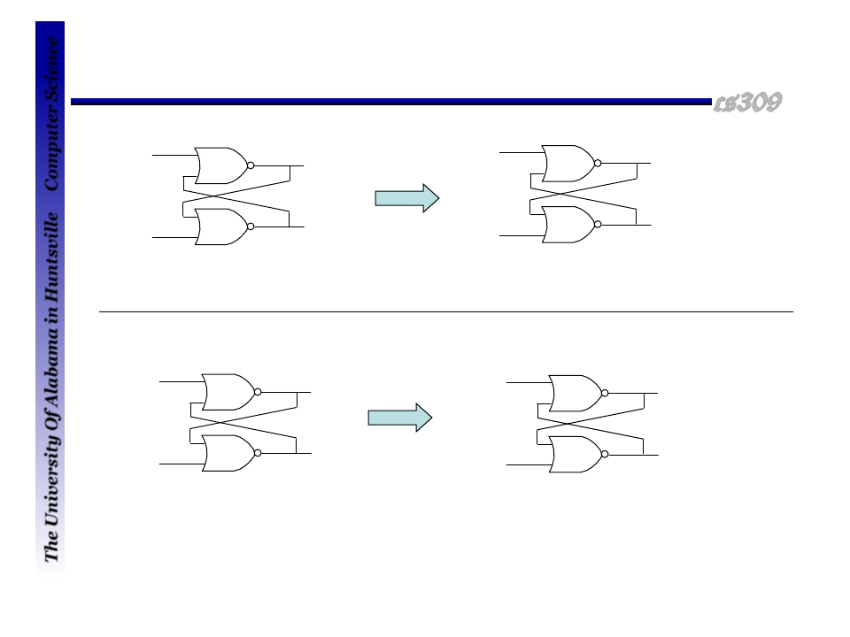
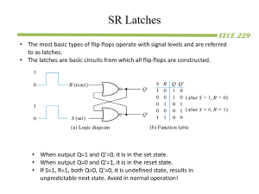
Shift to reset state by momentary apply S=0, R=1
How a latch holds a value
Removing 1 from R and the circuit remains in the reset state.
“Reset”
“Hold”
R
1
R
0
0
0
1
0
1
0
S
0
1
S
0
1
“Set”
“Hold”
R
0
R
0
1
1
0
1
0
1
S=0, R=0, Removing active input of S, leaves the circuit in the same state (set state)
S
1
0
S
0
0
S=1, R=0, Bring the circuit to set state
When S=0, R=0, the latch can either be in set/reset state, depending on which input is recently 1

Slide 9
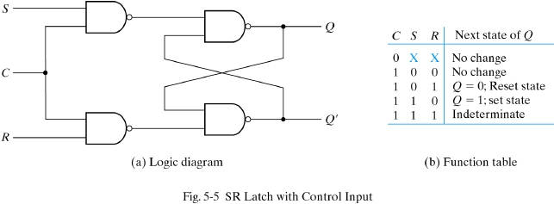
S-R Latch with NAND Gates
Control input
Symbol
Characteristic Table
S R
Q(t+1)
------------
S
Q
C
0 0
0 1
Q(t)
0
“Reset”
R
Q’
1 0
1 1
1 “Set”
Not allowed
A characteristic table defines the logical properties of a flip-flop by describing its operation in tabular form.

Slide 10
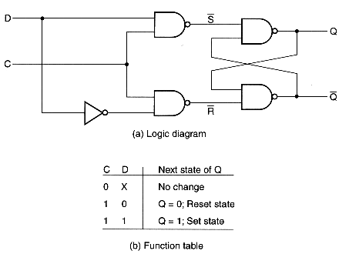
D Latches
One way to eliminate the indeterminate state in SR latches is to ensure S and R are never equal to 1 that can be done in D latches.
The D latches has two inputs: D(data) and C (control).
D input goes directly to S and its complement goes directly to R input.
When D=1, the Q=1, set state.
When D=0, the Q=0, reset state.

Slide 11
Flip-flops

Slide 12
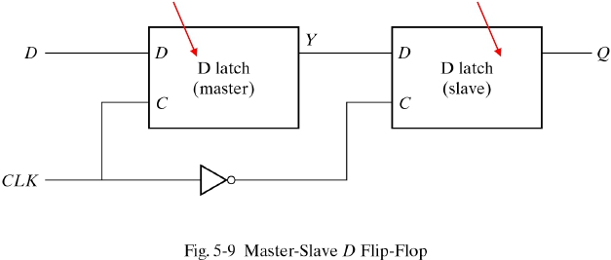
Edge-Triggered D Flip-Flop
We can construct a D flip-flop with two D latches.
When clock=0, the slave latch is enabled and its output Q = Y. master latch is disabled.
When clock =1, the master latch is enabled. External input D is transferred to Y. slave latch is disabled. When clock goes back to 0, Y is transferred to Q.
The output may change only during the negative edge of the clock.
Master Changes on the 0 → 1 transition
Slave Changes on the 1 → 0 transition

Slide 13
D Flip-Flop
Characteristic Table
D
Q
D
Q(t+1)
------------
0
1
0
1
C
Q’
Characteristic equation: Q(t+1) = D
The next state is dependent only on the D input and independent of the present state.
The next state value is equal to the value of D. Q(t+1) = D.
Notes:
Does not have a “no-change” condition. It can be accomplished by disabling the clock or by leaving the clock and connecting the output back into the D input.

Slide 14
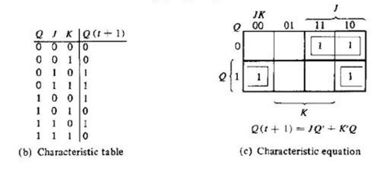
J-K Flip-Flop
Characteristic Table
J K Q(t+1)
------------
J
C
Q
K
Q’
0 0
0 1
1 0
1 1
Q(t)
0
1
Q’(t)
“Reset”
“Set”
“Complement”

Slide 15
T (“Toggle”) Flip-Flop
Characteristic Table
T
Q
T
Q(t+1)
------------
0
1
Q(t)
Q’(t)
C
Q’
When T=0, the clock edge does not change the state.
When T=1, the clock edge complements the state.
Characteristic equation: Q(t+1) = TQ’ + T’Q = T (XOR) Q

Slide 16
Sequential circuit analysis

Slide 17
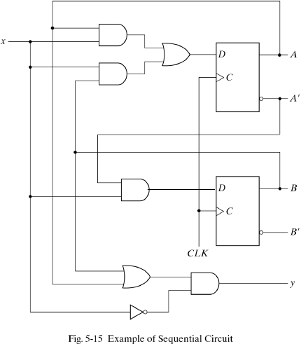
Example Circuit
Note:
The “state” of this circuit
is the output of the two
flip-flops: AB

Slide 18
State Equations
The State Equations specify
the next state of the circuit as a
function of the present state and
inputs.
Because these are D FF’s, the next
state is equal to the FF inputs
A(t+1) = A(t)x(t) + B(t)x(t)
B(t+1) = A’(t)x(t)
Usually, we drop the “(t)”:
A(t+1) = xA + xB
B(t+1) = A’x
Output:
y(t) = (A+B)x’

Slide 19
State Table
The time sequence of inputs, outputs, and flip-flops states can be enumerated in a state table, or transition table.
Present
State
A B
Input
x
Next
State
A B
Output
y
-----------------------------------
0 0
0 0
0 1
0 1
1 0
1 0
1 1
1 1
0
1
0
1
0
1
0
1
0 0
0 1
0 0
1 1
0 0
1 0
0 0
1 0
0
0
1
0
1
0
1
0
A(t+1) = xA + xB
B(t+1) = A’x
y = (A+B)x’

Slide 20
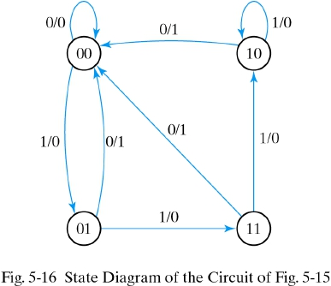
State Diagram
Present
State
A B
Input
x
Next
State
A B
Output
y
-----------------------------------
0 0
0 0
0 1
0 1
1 0
1 0
1 1
1 1
0
1
0
1
0
1
0
1
0 0
0 1
0 0
1 1
0 0
1 0
0 0
1 0
0
0
1
0
1
0
1
0

Slide 21
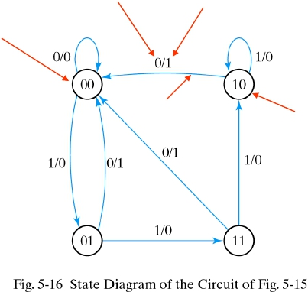
State Diagram
Input
Output
Next state
Present
State
Input
Next
State
Output
A B x A B y
-----------------------------------
0 0 0 0 0 0
Transition
Present state
0 0
0 1
0 1
1 0
1 0
1 1
1 1
1
0
1
0
1
0
1
0 1
0 0
1 1
0 0
1 0
0 0
1 0
0
1
0
1
0
1
0

Slide 22
Sequential circuit analysis (continued)

Slide 23
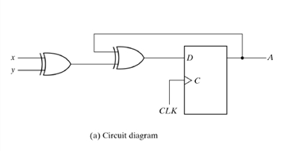

Slide 24
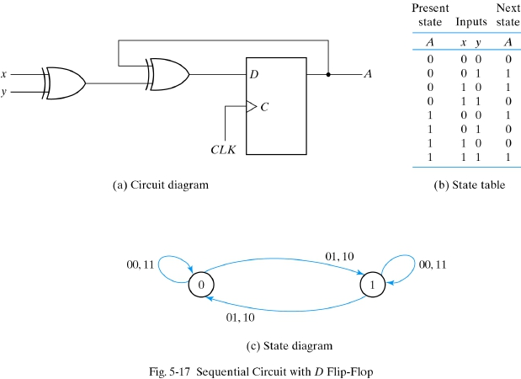
D-FF example
D = x XOR y XOR A
Note that since the
circuit output is the state,
we do not need to show
the output value on the
transition lines.

Slide 25
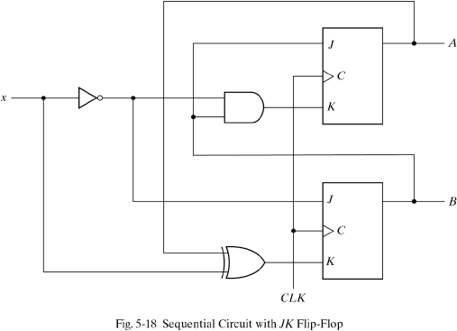
JK-FF Example
Input eqns:
JA = B
KA = x’B
JB = x’
KB = x XOR A

Slide 26

JK-FF Example (2)
Input eqns:
JA = B
KA = x’B
JB = x’
KB = x XOR A
Present
State
Input
Next
State
FF Inputs
--------------------------------------------
A B
x
A B
JA
KA
JB
KB
0 0
0 0
0 1
0 1
1 0
1 0
1 1
1 1
0
1
0
1
0
1
0
1
0 0 1 0
0 0 0 1
1 1 1 0
1 0 0 1
0 0 1 1
0 0 0 0
1 1 1 1
1 0 0 0

Slide 27

JK-FF Example (3)
Input eqns:
Characteristic Table
JA = B
KA = x’B
JB = x’
KB = x XOR A
J K Q(t+1)
------------
0 0 Q(t)
0 1 0
1 0 1
“Reset”
“Set”
1 1
FF Inputs
Q’(t)
“Complement”
Present
State
Input
Next
State
--------------------------------------------
A B
x
A B
JA
KA
JB
KB
0 0
0 0
0 1
0 1
1 0
1 0
1 1
1 1
0
1
0
1
0
1
0
1
0 1
0 0
1 1
1 0
1 1
1 0
0 0
1 1
0 0 1 0
0 0 0 1
1 1 1 0
1 0 0 1
0 0 1 1
0 0 0 0
1 1 1 1
1 0 0 0

Slide 28
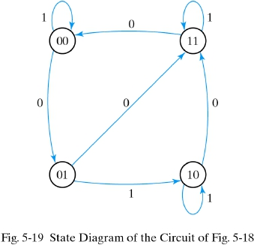
JK-FF Example (3)
Present
State
Input
Next
State
FF Inputs
-------------------------------------------
A B
x
A B
JA
KA
JB
KB
0 0
0 0
0 1
0 1
1 0
1 0
1 1
1 1
0
1
0
1
0
1
0
1
0 1
0 0
1 1
1 0
1 1
1 0
0 0
1 1
0 0 1 0
0 0 0 1
1 1 1 0
1 0 0 1
0 0 1 1
0 0 0 0
1 1 1 1
1 0 0 0
The information in the state table can be represented graphically in the form of a state diagram.

Slide 29
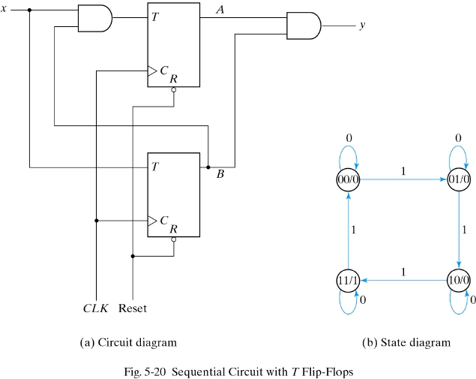
T-FF Example
Characteristic Table
T
Q(t+1)
------------
0
1
Q(t)
Q’(t)

Slide 30
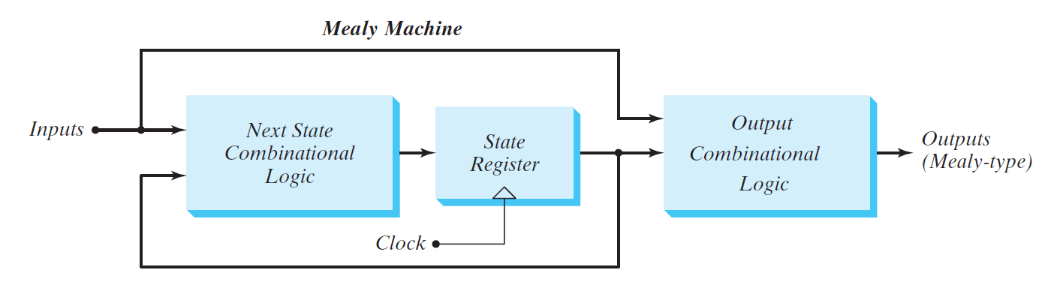
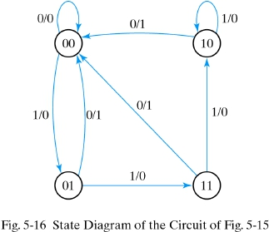
State Diagrams: Mealy and Moore Designs
y = (A+B)x’
In the Mealy model, the output is a function of both the present state and
the input.

Slide 31
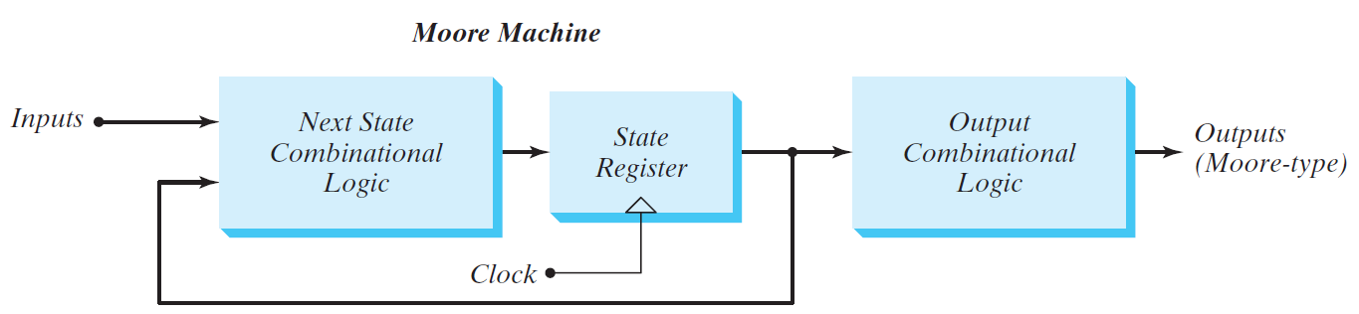
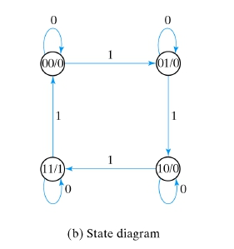
Mealy and Moore Designs
y = AB
In the Moore model, the output is a function of only the present state.
Notes:
The two models of a sequential circuit are commonly
referred to as a finite state machine, abbreviated FSM.

Slide 32
Analysis procedure
Build state table
Derive Boolean expressions for FF inputs in terms of present states. Get FF inputs in the state table.
Using characteristic table to get next states in the state table
Draw the state diagram

Slide 33
Sequential Circuit Synthesis

Slide 34
Synthesis procedure
Draw the state diagram
Assign binary codes to the states
Build the state table
Decide on FF types and write the FF input equations
Draw the logic diagram

Slide 35
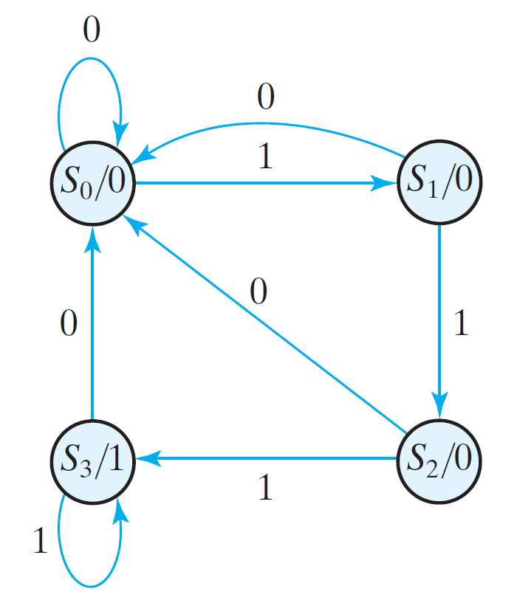
“111…” sequence detector
Design a circuit that detects a sequence of 3 or more consecutive 1’s
This is a Moore model sequential circuit since the output is 1 when the circuit is in S₃ state and 0 otherwise.
Notes:
Is it a mealy or moore machine?

Slide 36
Assign binary codes to the states
A B
---------
S0 0 0
S1 0 1
S2 1 0
S3 1 1
Note that there are
other ways to make
this assignment

Slide 37
Build the state table
A B
---------
S0 0 0
S1 0 1
S2 1 0
S3 1 1
A B
x
A B
y
-----------------------------------
0 0
0 0
0 1
0 1
1 0
1 0
1 1
1 1
0
1
0
1
0
1
0
1
0 0
0 1
0 0
1 0
0 0
1 1
0 0
1 1
0
0
0
0
0
0
1
1

Slide 38
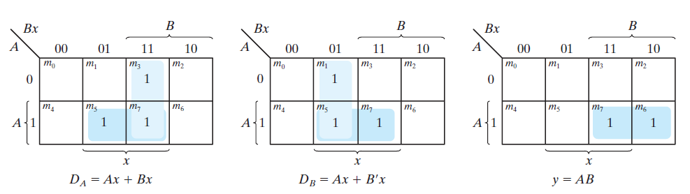

Determine FF Types and write the FF input equations
Say we use D-FF’s
Present
State
Input
Next Output
State
A B
x
A B
y
------------------------------------
0 0
0 0
0 1
0 1
1 0
1 0
1 1
1 1
0
1
0
1
0
1
0
1
0 0
0 1
0 0
1 0
0 0
1 1
0 0
1 1
0
0
0
0
0
0
1
1
y = Ax
K maps for sequence detector

Slide 39
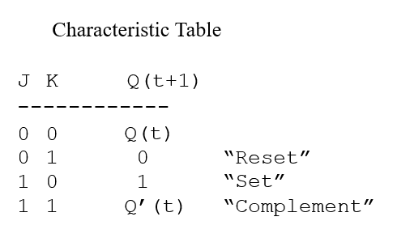
Making it easier to develop FF Input Equations
The “Excitation Table”
JK-FF
Q(t) Q(t+1) J K
------------------
0 0 0 d
0 1 1 d
1 0 d 1
1 1 d 0
D-FF
Q(t) Q(t+1) D
---------------
0 0 0
0 1 1
1 0 0
1 1 1
T-FF
Q(t) Q(t+1) T
---------------
0 0 0
0 1 1
1 0 1
1 1 0

Slide 40
A JK-FF Example (1)
State Table
Input
x
Present
State
A B
Next
State
A B
-------------------------
0 0
0 0
0 1
0 1
1 0
1 0
1 1
1 1
0
1
0
1
0
1
0
1
0 0
0 1
1 0
0 1
1 0
1 1
1 1
0 0

Slide 41
A JK-FF Example (2)
Present
State Table
Input
Next
JK Excitation Table
State State
A B x A B
-------------------------
0 0 0 0 0
0 0 1 0 1
0 1 0 1 0
0 1 1 0 1
Q(t) Q(t+1) J K
------------------
0 0 0 d
0 1 1 d
1 0 d 1
1 1 d 0
1 0
1 0
1 1
1 1
0
1
0
1
1 0
1 1
1 1
0 0
State Table with FF Inputs
Present
State
A B
Input
x
Next
State
A B
FF Inputs
J_{A} K_{A} J_{B} K_{B}
-----------------------------------------
0 0
0 0
0 1
0 1
1 0
1 0
1 1
1 1
0
1
0
1
0
1
0
1
0 0
0 1
1 0
0 1
1 0
1 1
1 1
0 0
0 d 0 d
0 d 1 d
1 d d 1
0 d d 0
d 0 0 d
d 0 1 d
d 0 d 0
d 1 d 1

Slide 42
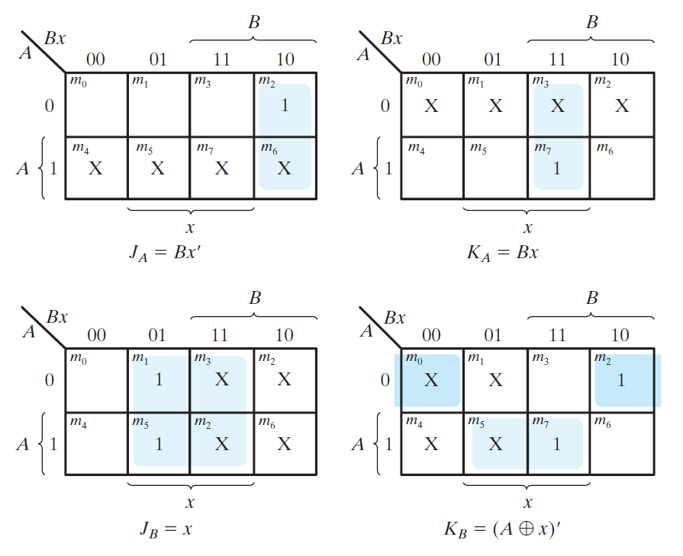
A JK-FF Example (3)
Present
State
A B
Input
x
Next
State
A B
FF Inputs
J_{A} K_{A} J_{B} K_{B}
-----------------------------------------
0 0
0 0
0 1
0 1
1 0
1 0
1 1
1 1
0
1
0
1
0
1
0
1
0 0
0 1
1 0
0 1
1 0
1 1
1 1
0 0
0 d 0 d
0 d 1 d
1 d d 1
0 d d 0
d 0 0 d
d 0 1 d
d 0 d 0
d 1 d 1

Slide 43
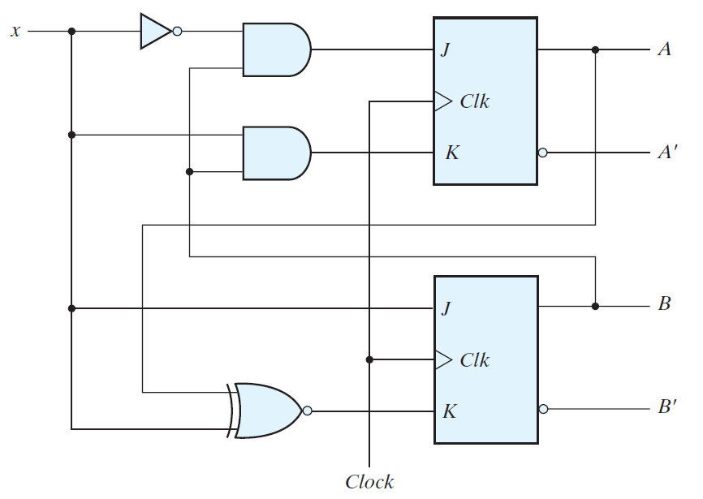
A JK-FF example (4)
J_{A} = Bx’
K_{A}= Bx
J_{B}= x
K_{B} = (A XOR x)’

Slide 44
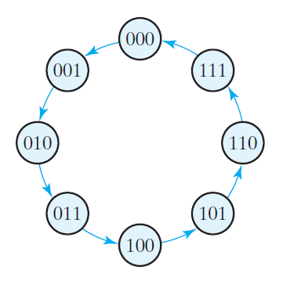
A simple binary counter
State Diagram of 3-bit Binary Counter

Slide 45
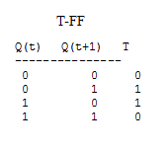
State diagram, state table, FF inputs
FF inputs
For T Flip Flops
Next
Present
A2 A1 A0
A2 A1 A0
TA2
TA1
TA0
-------------------------------
0 0 0
0 0 1
0 0 1
0 0 1 0 1 0
0 1 1
0 1 0 0 1 1 0 0 1
0 1 1 1 0 0 1 1 1
1 0 0 1 0 1 0 0 1
1 0 1 1 1 0 0 1 1
1 1 0 1 1 1 0 0 1
1 1 1 0 0 0 1 1 1
Use K-Maps to determine:
TA2 = A1A0
TA1 = A0
TA0 = 1

Slide 46
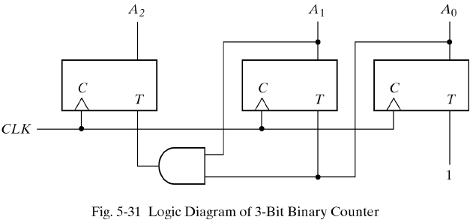
Circuit

Slide 47
State reduction

Slide 48
State Reduction
The analysis of sequential circuits starts from a circuit diagram and culminates in a state table or diagram.
The reduction of the number of flip-flops in a sequential circuit is referred to as the state-reduction problem.
Since m flip-flops produce 2^{m} states, a reduction in the number of flip-flops.

Slide 49
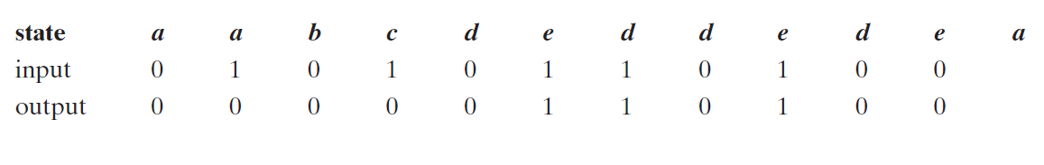
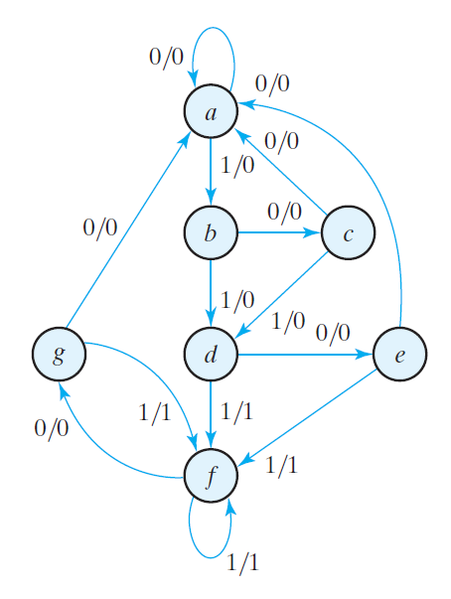
State Reduction

Slide 50
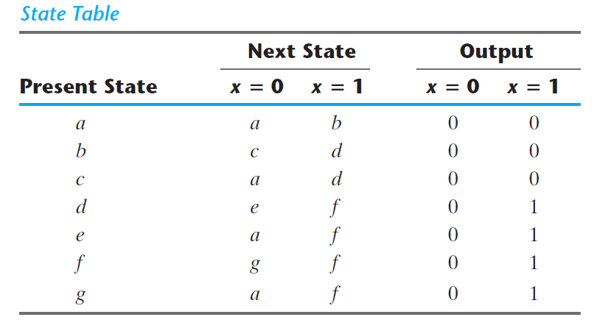
State Reduction
We now proceed to reduce the number of states for this example. First, we need the state table; it is more convenient to apply procedures for state reduction using a table rather than a diagram.

Slide 51
State Reduction
States g and e are two such states: they both go to states a and f and have outputs of 0 and 1 for x=0 and x=1, respectively. Therefore, states g and e are equivalent and one of these states can be removed.

Slide 52
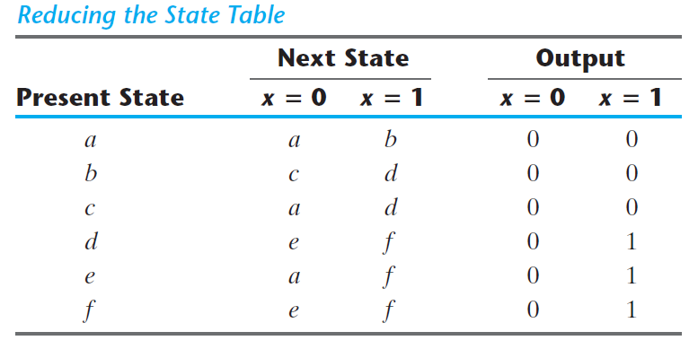
State Reduction
States g and e are two such states: they both go to states a and f and have outputs of 0 and 1 for x=0 and x=1, respectively. Therefore, states g and e are equivalent and one of these states can be removed.

Slide 53
State Reduction
Present state f and d now has next states e and f and outputs 0 and 1 for x=0 and x=1, respectively. Therefore, states f and d are equivalent.

Slide 54
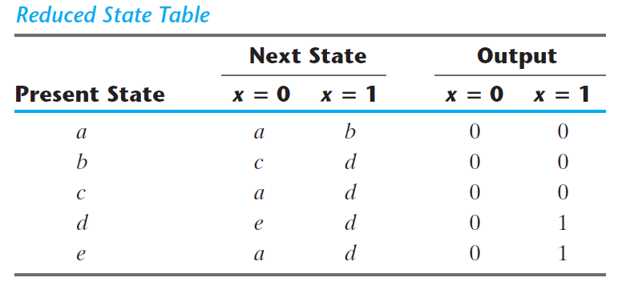
State Reduction
Present state f and d now has next states e and f and outputs 0 and 1 for x=0 and x=1, respectively. Therefore, states f and d are equivalent.

Slide 55
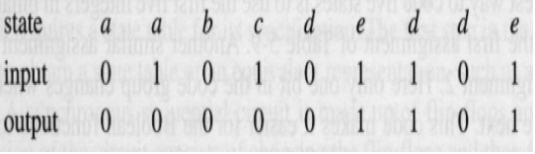
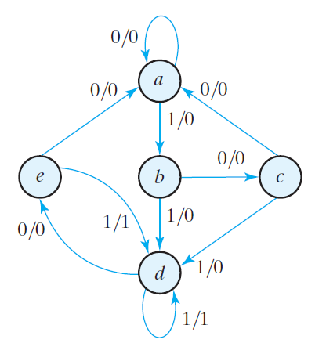
State Reduction

Slide 56
Conclusion
Know what is a sequential circuit
Know circuits of latches
Know D flip-flops, J-K flip-flops, and T flip-flops. The characteristic equation, characteristic table and excitation table
Know the steps to analyze a sequential circuit. Given a circuits, you should be able to derive state equations, state tables and state diagrams
Know the difference between Mealy machine and Moore machine
Know the procedure to synthesis a sequential circuit given a design problem
Should be able to use D flip-flops, J-K flip-flops or T flip-flops to synthesis a sequential circuit
Know state reduction given a state diagram

Slide 57
Reference:
Some of the artwork and graphs are from the following books:
1. Fundamentals of Digital Logic with Verilog design, by Stephen Brown and Zvonko Vranesic, 3rd edition, McGraw Hill
2. Digital Design, 5th Edition, By M. Morris Mano, Michael D. Ciletti, Prentice Hall.

